Slide 1
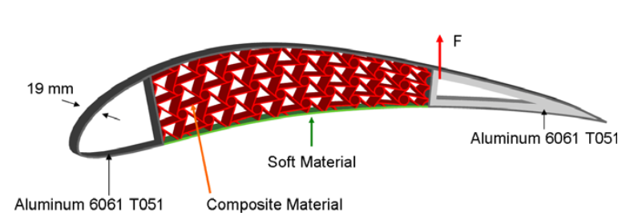
Topology Optimization of a Feasible Morphing Wing using Nonlinear Elasticity
Gabriele capasso
Tutors: Joseph morlier, miguel charlotte, SIMONE CONIGLIO

Slide 2
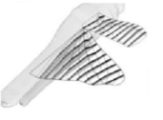
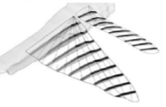
How do insepts fly?
[1] J. Valasek, Morphing Aerospace Vehicles and Structures, John Wiley & Sons Ltd, 2012

Slide 3
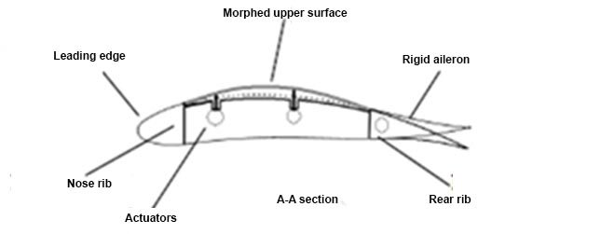
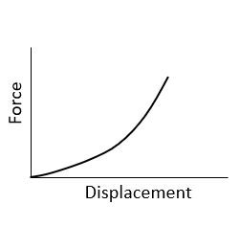
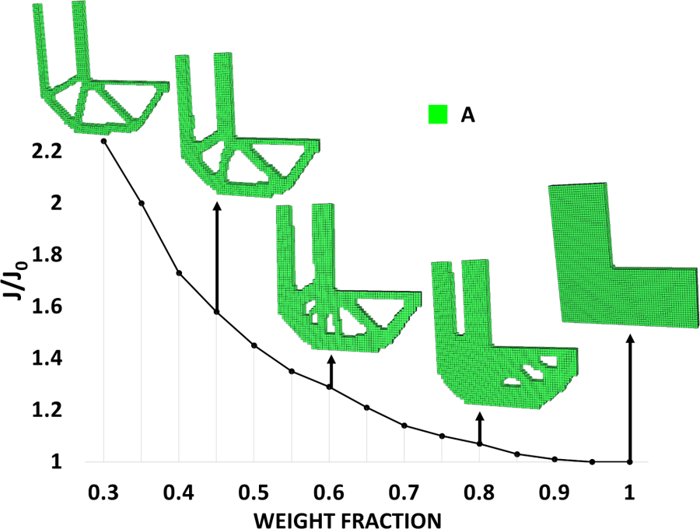
Context
Ref: [2]
Morphing wing
Ref: [3]
Ref: [4]
Nonlinear Mechanics
Topology Optimization
(TO)

Slide 4
Summary
TO: how does it work?
Problem Statement
Procedures:
Boundary Conditions and Parameters
FE – Analysis
Stress Evaluation
Adjoint Sensitivity Analysis
Results:
First results
Influence of Constraints, BCs, Force
Conclusions

Slide 5
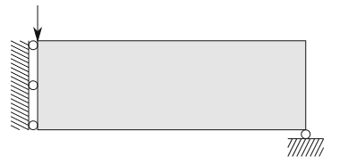

TO: how does it work?
Arranging masses where necessary
SIMP approach: each FE is associated with a fictitious pseudo-density $0≤ρ≤1$
Iterative process
Top88: our reference
Examples of SIMP application with different desired volume fraction: 0.5 in (a) and 0.3 in (b). Ref: [7]
(a)
(b)

Slide 6
START
Static force equilibrium
FE Analysis
Constraints evaluation
Depends on the problem
Adjoint Sensitivity
Analysis
Examples of SIMP application with different desired volume fraction: 0.5 in (a) and 0.3 in (b). Ref: [7]
Derivatives evaluation
Update densities
Optimizer: MMA, OC
(a)
Mesh-independency filter
NO
YES
Converged?
(b)
END

Slide 7
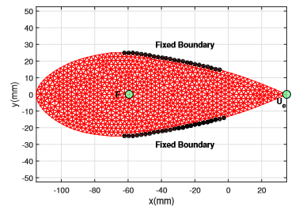





Problem statement
Light (volume fraction)
Ref [8]
$$minimize V(ρ)$$
$$subject to$$
$$U_{e}(ρ)≥U_{0}$$
Morphing
$$σ_{i}(ρ,U_{f}(ρ))≤σ_{lim}$$
Feasible
Nonlinear potential density:
$$Φ=\frac{1}{2}λ_{0}{\left[\ln\left(J\right)\right]}^{2}−μ_{0}\ln\left(J\right)+\frac{1}{2}μ_{0}\left[tr\left(C\right)−3\right]$$
$$with J=\det\left(F\right) F=\frac{dx}{dX} C=F^{T}F$$
Ref [2]
[9] A. Bhattacharyya, C. Conlan-Smith, and K. A. James, “Topology optimization of a bi-stable airfoil using nonlinear elasticity,” in 18th AIAA/ISSMO Multidisciplinary Analysis and Optimization Conference. American Institute of Aeronautics and Astronautics, Jun 2017.
[3] N.-H. Kim, Introduction to Nonlinear Finite Element Analysis. Springer US, 2014 .

Slide 8
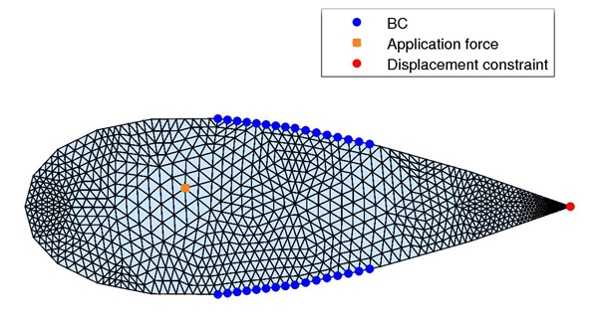

Boundary Conditions and Parameters
Young Modulus $E_{0} [MPa]$ | $$15$$
Poisson ratio $ν$ | $$0,3$$
Lamé’s first parameter $λ_{0} [MPa]$ | $$8,65$$
Lamé’s second parameter $μ_{0} [MPa]$ | $$5,77$$
Displacement constraint $U_{0} [mm]$ | $$−21$$
Stress constraint $σ_{max} [MPa]$ | $$1$$
Abscissa force’s application point $x_{app}/c$ | $$0,3$$
Ordinate force’s application point $y [mm]$ | $$5$$
Intensity applied force $F_{ext} \left[N/mm\right]$ | $$7$$
Limits of Boundary Conditions $x/c$ | $$0,35−0,65$$
Penalization factor $p$ | $$3,0$$
Initial domain

Slide 9
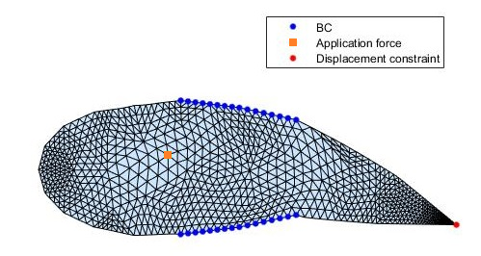





FE - Analysis
Sub-optimization problem
Objective function: total energy $E_{T}$
Variables: nodal displacement $q$
We have objective function, gradient, hessian and BCs
fmincon
$$E_{T}=E_{int}−F_{app}U_{app}=\int_{Ω}{Φ dΩ}−F_{app}U_{app}$$
$$Φ=\frac{1}{2}λ_{0}{\left[\ln\left(J\right)\right]}^{2}−μ_{0}\ln\left(J\right)+\frac{1}{2}μ_{0}\left[tr\left(C\right)−3\right]$$
$$Residual (gradient): R=\frac{dE_{T}}{dq^{T}}=F_{int}−F_{ext}$$
$$Internal Forces: F_{int}=\frac{dE_{int}}{dq^{T}}=\int_{Ω}{\frac{dΦ}{dq^{T}}dΩ}$$
Example of nonlinear FEM (horizontal force of 7 N/mm)
$$Tangent Stiffness Matrix (Hessian): K_{T}=\frac{dF_{int}}{dq}=\int_{Ω}{\frac{d^{2}Φ}{dqdq^{T}}dΩ}=\frac{d^{2}E_{T}}{dqdq^{T}}$$

Slide 10



Stress Evaluation: relaxation
Hypothesis: plane strain
Use of CST elements: constant stress for each element
PROBLEM: Microscopic or macroscopic stress?
SOLUTION: Relaxed stress constraint ${\overline{g}}_{i}$
$${\overline{g}}_{i}=ρ_{i}\left(\frac{σ_{VMi}}{σ_{max}}−1\right)≤0 ∀ i=1,…,N$$
$$σ_{VMi}≤σ_{max} ∀ i=1,…,N$$
(N constraints)
(still N constraints)
PROBLEM: Aren’t N constraints excessives?

Slide 11






Stress Evaluation: aggregation
FIRST SOLUTION: just the max is considered. But is it derivable?
PROBLEM: Aren’t N constraints excessives?
SOLUTION: Approximation of $max\left({\overline{g}}_{i}\right)$
$$K_{GS}=\frac{1}{P}\log\left(\frac{1}{N}\sum_{i}{e^{P{\overline{g}}_{i}}}\right)$$
$${\overline{g}}_{i}≤0 ∀ i$$
$max\left({\overline{g}}_{i}\right)≤0$
High $P$:
High Precision
High Computation cost
Low $P$:
Low Precision
Low Computation cost

Slide 12




Adjoint Sensitivity Analysis
WHAT: to consider a Lagrangian augmented function $L=f+λ^{T}R$
WHO’s $f$: either objective or constraint functions
WHY: constraint and objective functions depend both on $U_{f}$ and $ρ$
WHEN: introduction of derivatives to the gradient-based optimizer (MMA)
If the Lagrangian multiplier:
$$λ=−K_{T}^{−T}{\frac{∂f}{∂U_{f}}}^{T}$$
$$\frac{dL}{dρ}=\frac{∂f}{∂ρ}+λ^{T}\frac{∂R}{∂ρ}$$
WE DELETE THE MUTUAL DEPENDENCES BETWEEN $U_{f}$ AND $ρ$!

Slide 13
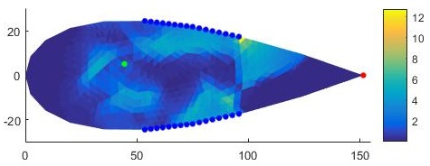
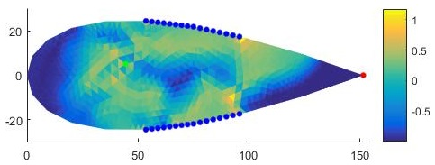


Results’ quality
$$λ_{e}=ρ_{e}^{p}λ_{0}$$
$$μ_{e}=ρ_{e}^{p}μ_{0}$$
Microscopic Stress
“EMPTY”
Relaxed Constraint
$$ρ_{e}=0,1$$

Slide 14
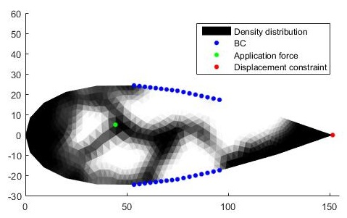
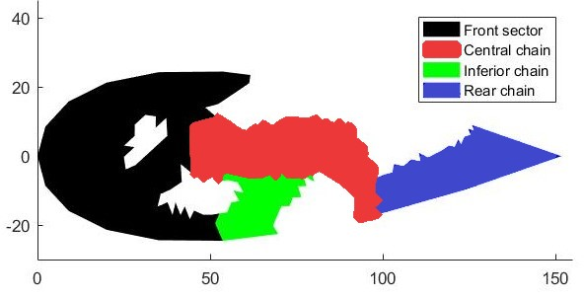
First results
Four main parts:
Front sector
Central chain
Inferior chain
Rear chain
Volume fraction obtained:
0,5164

Slide 15
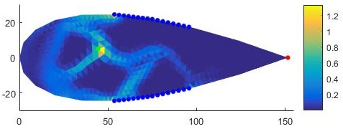
First results
Four main parts:
Front sector
Central chain
Inferior chain
Rear chain
NO FRONT SECTOR,
NO FEASIBILITY
Macroscopic Stress

Slide 16
First results
Four main parts:
Front sector
Central chain
Inferior chain
Rear chain
NO CENTRAL CHAIN,
NO FORCE TRANSMISSION
Macroscopic Stress

Slide 17
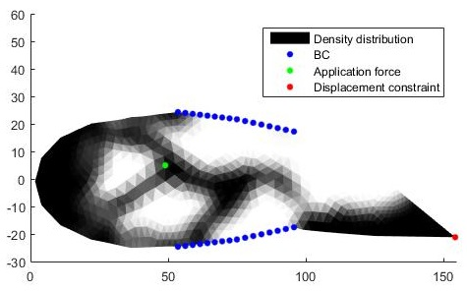
First results
Four main parts:
Front sector
Central chain
Inferior chain
Rear chain
NO INFERIOR CHAIN,
NO EQUILIBRIUM

Slide 18
First results
Four main parts:
Front sector
Central chain
Inferior chain
Rear chain
NO REAR CHAIN,
NO MORPHING

Slide 19
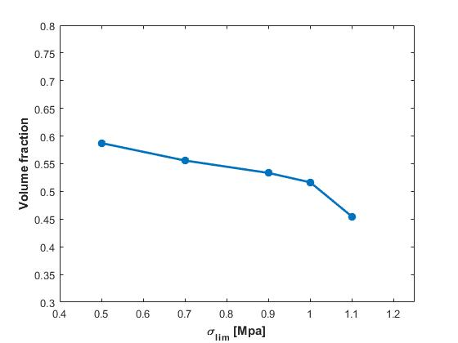
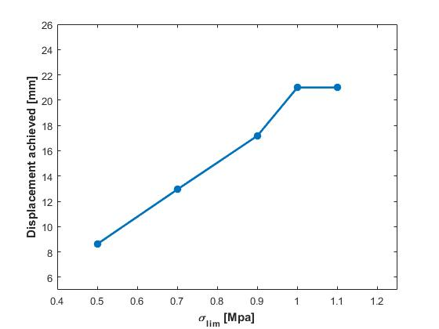
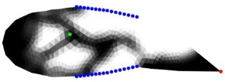
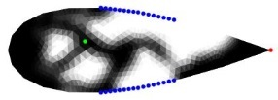
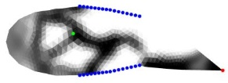
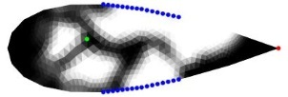
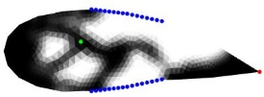
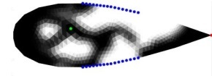
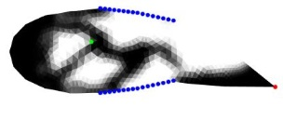

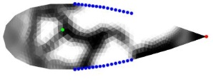
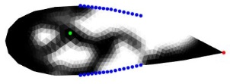
Influence of Constraints

Slide 20
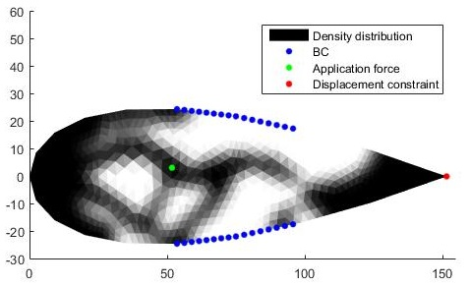
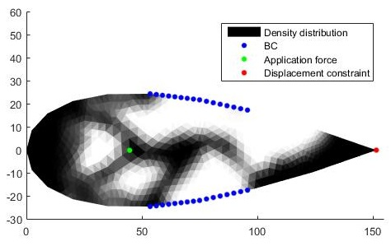
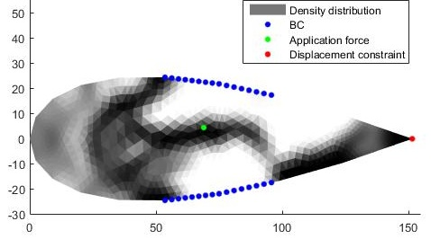
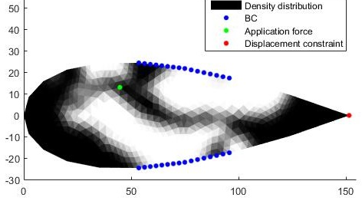




Influence of the position of Force
$$x_{app}=0,35c$$
$$V=0,5456$$
$$U_{e}=16 mm$$
$$y_{app}=0 mm$$
$$V=0,5200$$
$$U_{e}=21 mm$$
$$x_{app}=0,45c$$
$$V=0,4752$$
$$U_{e}=21 mm$$
$$y_{app}=15 mm$$
$$V=0,5324$$
$$U_{e}=16 mm$$

Slide 21
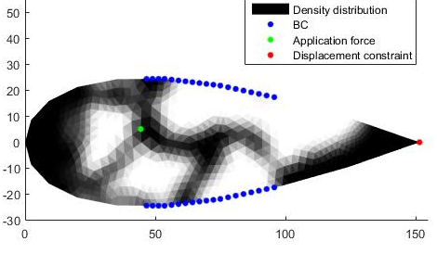
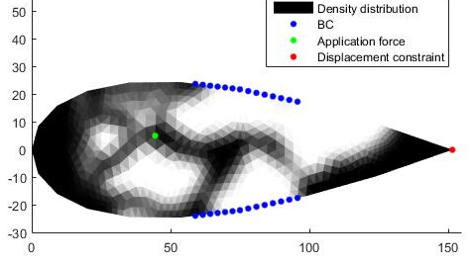
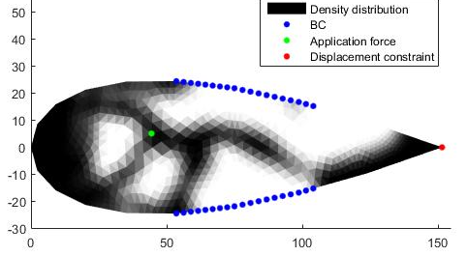
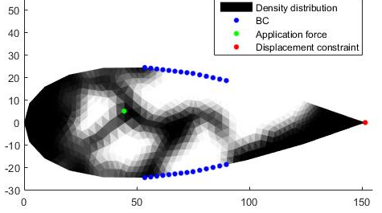




Influence of Boundary Conditions
$V=0,5035$
$$\text{BC}\text{: 30−65\%}$$
$$U_{e}=21 mm$$
$V=0,5182$
$$\text{BC}\text{: }\text{40}\text{−65\%}$$
$$U_{e}=21 mm$$
$V=0,4959$
$$\text{BC}\text{: 3}\text{5}\text{−}\text{70}\text{\%}$$
$$U_{e}=21 mm$$
$V=0,5336$
$$\text{BC}\text{: 3}\text{5}\text{−6}\text{0}\text{\%}$$
$$U_{e}=21 mm$$

Slide 22

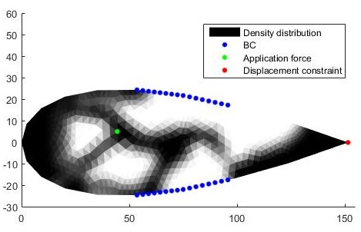


Influence of Force Intensity
$$F_{app}=5 N/mm$$
$$V=0,5020$$
$$U_{e}=21 mm$$
Nothing special, but…
$$F_{app}=8 N/mm$$
$$V=0,5235$$
$$U_{e}=21 mm$$

Slide 23
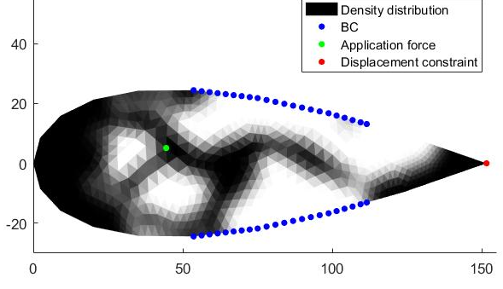
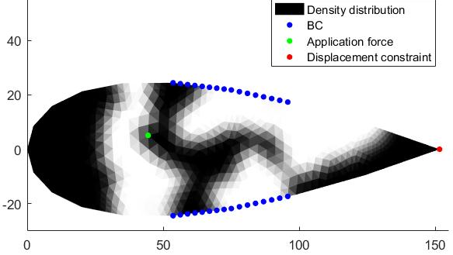
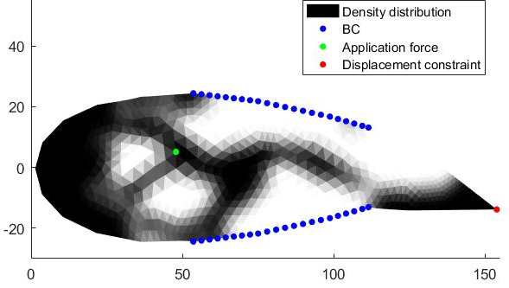


More doesn’t mean better…
$$BC=35−75\%$$
$$V=0,5311$$
$$U_{e}=13,89 mm$$
$$F_{app}=9 N/mm$$
NUMERICAL INSTABILITIES

Slide 24
Conclusions
A feasible morphing wing has been designed
It presents the minimum volume fraction possible
According to the resistance, performance could be penalized
According to the BCs, respect of constraints not guaranteed
Force position changes all the topology
Force intensity show trivial results… till the limits of numerical stability
IT WILL ALWAYS BE AN OPEN PROBLEM!

Slide 25
Thank you for your attention!
QUESTIONS?

Slide 26
References
[1] J. Valasek, Morphing Aerospace Vehicles and Structures, John Wiley & Sons Ltd, 2012
[2] Tchatchueng Kammegne, M. J., Grigorie, L. T., Botez, R. M., “Design, Numerical Simulation and Experimental Testing of a Controlled Electrical Actuation System in a Real Aircraft Morphing Wing Model “, The Aeronautical Journal, Vol. 119,2015
[3] N.-H. Kim, Introduction to Nonlinear Finite Element Analysis. Springer US, 2014 .
[4] K. Suresh and A. M. Mirzendehel, A Hands-on Introduction to Topology Optimization. Springer US, 2017.
[5] S. Joshi, Z. Tidwell, W. Crossley, and S. Ramakrishnan, “Comparison of morphing wing stategies based upon aircraft performance impacts,” in 45th AIAA/ASME/ASCE/AHS/ASC Structures, Structural Dynamics Materials Conference. American Institute of Aeronautics and Astronautics, Apr 2004.
[6] J. M. Martinez, D. Scopelliti, C. Bil, R. Carrese, P. Marzocca, E. Cestino, and G. Frulla, “Design, analysis and experimental testing of a morphing wing,” in 25th AIAA/AHS Adaptive Structures Conference. American Institute of Aeronautics and Astronautics, Jan 2017.
[7] E. Andreassen, A. Clausen, M. Schevenels, B. S. Lazarov, and O. Sigmund, “Efficient topology optimization in MATLAB using 88 lines of code,” Structural and Multidisciplinary Optimization, vol. 43, no. 1, pp. 1–16, Nov 2010.
[8]C. B. W. Pedersen, T. Buhl, and O. Sigmund, “Topology synthesis of large-displacement compliant mechanisms,” International Journal for Numerical Methods in Engineering, vol. 50, no. 12, pp. 2683–2705, 2001.
[9] A. Bhattacharyya, C. Conlan-Smith, and K. A. James, “Topology optimization of a bi-stable airfoil using nonlinear elasticity,” in 18th AIAA/ISSMO Multidisciplinary Analysis and Optimization Conference. American Institute of Aeronautics and Astronautics, Jun 2017.
[10] Verbart, Alexander, Matthijs Langelaar, and Fred Van Keulen. "A unified aggregation and relaxation approach for stress-constrained topology optimization." Structural and Multidisciplinary Optimization 55.2 (2017): 663-679.
[11] O. Sigmund, “A 99 line topology optimization code written in matlab,” Structural and Multidisciplinary Optimization, vol. 21, no. 2, pp. 120– 127, Apr 2001.
[12] K. Svanberg, “The method of moving asymptotes—a new method for structural optimization,” International Journal for Numerical Methods in Engineering, vol. 24, no. 2, pp. 359–373, Feb 1987.

